Slide 1
Tutorial on Longer Pipeline and Branch Prediction

Slide 2
TRUE/FALSE
Which of the following statements is/are FALSE?
(I) For a MIPS multi-cycle floating point pipeline the initiation interval of FP-mul is larger than that of FP-add
(II) WAW hazard cannot happen in a MIPS multi-cycle floating point pipeline.
(III) In a MIPS multi-cycle floating point pipeline that supports operand forwarding, there will be 7 stalls between a pair of adjacent MUL instructions that has a RAW dependency between them.
(IV) A (2,3) type branch predictor uses the outcome of the last 2³ (8) branches to index into the BPB where each entry has a 3-bit predictor.
(A) III only
(B) I only
(C) I & IV only
(D) I, II, III & IV

Slide 3
Multi-cycle operations
(I) For a MIPS multi-cycle floating point pipeline the initiation interval of FP-mul is larger than that of FP-add

Slide 4
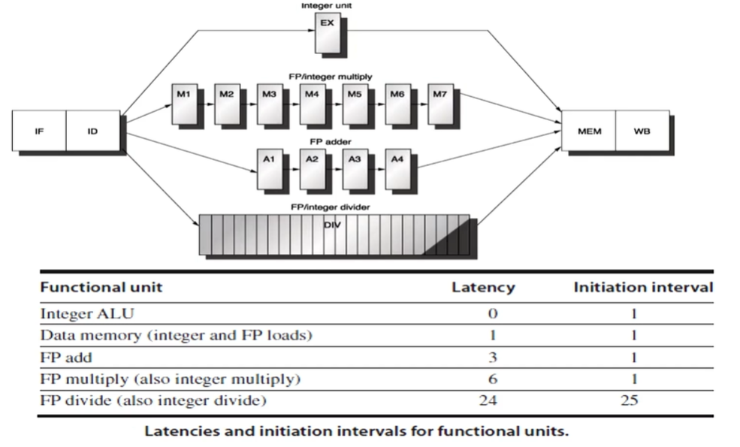
Multi-cycle operations
(I) For a MIPS multi-cycle floating point pipeline the initiation interval of FP-mul is larger than that of FP-add

Slide 5
Multi-cycle operations
(I) For a MIPS multi-cycle floating point pipeline the initiation interval of FP-mul is larger than that of FP-add: FALSE

Slide 6
Multi-cycle operations
(II) WAW hazard cannot happen in a MIPS multi-cycle floating point pipeline

Slide 7
Multi-cycle operations
(II) WAW hazard cannot happen in a MIPS multi-cycle floating point pipeline
Instruction | 1 | 2 | 3 | 4 | 6 | 7 | 8 | 9 | 10 | 11 | 12
MUL.D | IF | ID | M1 | M2 | M3 | M4 | M5 | M6 | M7 | MEM | WB
ADD.D |  | IF | ID | A1 | A2 | A3 | A4 | MEM | WB
L.D |  |  | IF | ID | EX | MEM | WB
S.D |  |  |  | IF | ID | EX | MEM | WB

Slide 8
Multi-cycle operations
(II) WAW hazard cannot happen in a MIPS multi-cycle floating point pipeline: FALSE
Instruction | 1 | 2 | 3 | 4 | 6 | 7 | 8 | 9 | 10 | 11 | 12
MUL.D | IF | ID | M1 | M2 | M3 | M4 | M5 | M6 | M7 | MEM | WB
ADD.D |  | IF | ID | A1 | A2 | A3 | A4 | MEM | WB
L.D |  |  | IF | ID | EX | MEM | WB
S.D |  |  |  | IF | ID | EX | MEM | WB

Slide 9
Multi-cycle operations
(III) In a MIPS multi-cycle floating point pipeline that supports operand forwarding, there will be 7 stalls between a
pair of adjacent MUL instructions that has a RAW dependency between them.

Slide 10
Multi-cycle operations
(III) In a MIPS multi-cycle floating point pipeline that supports operand forwarding, there will be 7 stalls between a
pair of adjacent MUL instructions that has a RAW dependency between them.
Instruction | 1 | 2 | 3 | 4 | 6 | 7 | 8 | 9 | 10 | 11 | 12
MUL F1,F2,F3 | IF | ID | M1 | M2 | M3 | M4 | M5 | M6 | M7 | MEM | WB
MUL F0, F1, F3 |  | IF | ID | * | * | * | * | * | * | M1 | M2

Slide 11
Multi-cycle operations
(III) In a MIPS multi-cycle floating point pipeline that supports operand forwarding, there will be 7 stalls between a
pair of adjacent MUL instructions that has a RAW dependency between them. FALSE
Instruction | 1 | 2 | 3 | 4 | 6 | 7 | 8 | 9 | 10 | 11 | 12
MUL F1,F2,F3 | IF | ID | M1 | M2 | M3 | M4 | M5 | M6 | M7 | MEM | WB
MUL F0, F1, F3 |  | IF | ID | * | * | * | * | * | * | M1 | M2

Slide 12
(p,q) Type Branch Predictor
(IV) A (2,3) type branch predictor uses the outcome of the last 2³ (8) branches to index into the BPB where each entry
has a 3-bit predictor.

Slide 13
(p,q) Type Branch Predictor
(IV) A (2,3) type branch predictor uses the outcome of the last 2³ (8) branches to index into the BPB where each entry
has a 3-bit predictor. FALSE
A (p,q) type predictor uses the outcome of the last 'p' branches to index into the BPB. Each of the entries will be a q-bit predictor updated by a 2^{q} state finite state machine.
Therefore, (2, 3) type branch predictor uses the outcome of the last 2 branches to index into the BPB where each entry has a 3-bit predictor. (NN, NT, TN, TT)
Hence the statement: "A (2,3) type branch predictor uses the outcome of the last 2³ (8) branches to index into the BPB where each entry has a 3-bit predictor" is wrong.

Slide 14
TRUE/FALSE
Which of the following statements is/are FALSE?
(I) For a MIPS multi-cycle floating point pipeline the initiation interval of FP-mul is larger than that of FP-add
(II) WAW hazard cannot happen in a MIPS multi-cycle floating point pipeline.
(III) In a MIPS multi-cycle floating point pipeline that supports operand forwarding, there will be 7 stalls between a pair of adjacent MUL instructions that has a RAW dependency between them.
(IV) A (2,3) type branch predictor uses the outcome of the last 2³ (8) branches to index into the BPB where each entry has a 3-bit predictor.
(A) III only
(B) I only
(C) I & IV only
(D) I, II, III & IV

Slide 15
Branch Prediction
Consider the last 16 actual outcomes of a single static branch. T means branch is taken and N means not taken.
{oldest -> T T N N T N T T T N T N T T N T <- latest}
A two level branch predictor of (1,2) type is used. Since there is only one branch in the program indexing to BHT with PC is irrelevant. Hence only last branch outcome only is used to index to the BHT. How many mis-predictions are there and which of the branches in this sequence would be mis-predicted? Fill up the table for 16 branch outcomes.

Slide 16
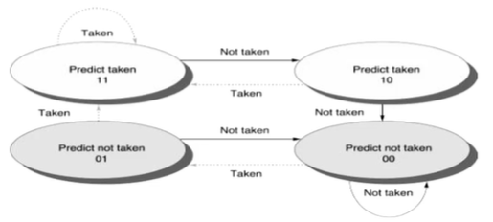
Branch Prediction
Consider the last 16 actual outcomes of a single static branch. T means branch is taken and N means not taken.
{oldest -> T T N N T N T T T N T N T T N T <- latest}
A two level branch predictor of (1,2) type is used. Since there is only one branch in the program indexing to BHT with PC is irrelevant. Hence only last branch outcome only is used to index to the BHT. How many mis-predictions are there and which of the branches in this sequence would be mis-predicted? Fill up the table for 16 branch outcomes.

Slide 17
Sl. No | Last Outcome | BHT N/T | Prediction | Outcome | Mis-Pre Y/N ?
1 | N (initial) | 00 / 01 | N | T | YES
2
3
4
5
6
7
8
9
10
11
12
13
14
15
16

Slide 18
Sl. No | Last Outcome | BHT N/T | Prediction | Outcome | Mis-Pre Y/N ?
1 | N (initial) | 00 / 01 | N | T | YES
2 | T | 01 / 11 | T | T | NO
3 | T | 01 / 11 | T | N | YES
4 | N | 01 / 10 | N | N | NO
5 | N | 00 / 10 | N | T | YES
6 | T | 01 / 10 | T | N | YES
7 | N | 01 / 00 | N | T | YES
8 | T | 11 / 00 | N | T | YES
9 | T | 11 / 01 | N | T | YES
10 | T | 11 / 11 | T | N | YES
11 | N | 11 / 10 | T | T | NO
12 | T | 11 / 10 | T | N | YES
13 | N | 11 / 00 | T | T | NO
14 | T | 11 / 00 | N | T | YES
15 | T | 11 / 01 | N | N | NO
16 | N | 11 / 00 | T | T | NO

Slide 19
Branch Prediction
Consider a (2,2) type branch predictor. BHT is indexed by the outcome of the last 2 branches. The BPB is initialized for NN/NT/TN/TT as 00/00/11/11 and is indexed with an NN entry in the first reference. Consider the last 8 actual outcomes of a single static branch, {oldest -> N N T T T N N T -> latest} where T means branch is taken and N means not taken. What will be the contents of BPB after the execution of the above mentioned 6 branch outcomes?

Slide 20
Branch Prediction
Consider a (2,2) type branch predictor. BHT is indexed by the outcome of the last 2 branches. The BPB is initialized for NN/NT/TN/TT as 00/00/11/11 and is indexed with an NN entry in the first reference. Consider the last 8 actual outcomes of a single static branch, {oldest -> N N T T T N N T -> latest} where T means branch is taken and N means not taken. What will be the contents of BPB after the execution of the above mentioned 6 branch outcomes?

Slide 21
Branch Prediction - Illustration
Sl. No | Last Outcome | BPB NN/NT/TN/TT | Prediction | Outcome | Misprediction Y/N ?
1 | NN (Initial) | 00/00/11/11 | N | N | NO
2 | NN | 00/00/11/11 | N | N | NO
3 | NN | 00/00/11/11 | N | T | YES
4 | NT | 01/00/11/11 | N | T | YES
5 | TT | 01/01/11/11 | T | T | NO
6 | TT | 01/01/11/11 | T | N | YES
7 | TN | 01/01/11/10 | T | N | YES
8 | NN | 01/01/10/10 | N | T | YES
 |  | 11/01/10/10
(2,2) type branch predictor. Initial: NN/NT/TN/TT – 00/00/11/11.
Last 8 outcomes, {oldest N N T T T N N T latest}

